Slide 1
Tanzania waterwells prediction
Benson Mungai Muriu

Slide 2
Objectives
Waterpoints in Tanzania
Features that influence the status of waterpoints in Tanzania
Findings
Recommendations

Slide 3
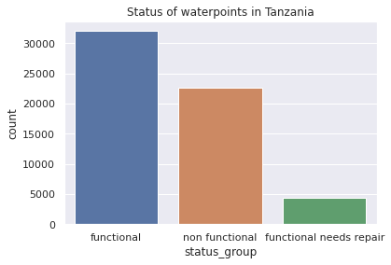
Waterpoints in Tanzania
The water points were recorded between 2011 to 2013.
There are a total of about 59,000 water points in Tanzania as of 2013
32,054 water points are functional in Tanzania.
22,659 water points are non-functional in Tanzania.
4,316 water points are functional but need repair .

Slide 4
Features that influence status of waterpoints in Tanzania
Locational data : gps_height, installer, longitude , Latitude ,Basin and Region.
Population - How many people live around the water points.
Public_meeting - did the people have a public meeting for the water point.
Permit- does the waterpoint have a permit
Extraction_type_group- how the water is extracted eg. gravity
Management - who manages the water point.
Payment - what type of payment is done at the waterpoint.
Water_quality - quality of water e.g good or salty

Slide 5
features
Quantity - amount of water at waterpoint
Source - source of water at the waterpoint.
Waterpoint_type- e.g communalstandpipe, handpipe etc
Construction_year_bins - the year the waterpoint was constructed grouped between 10years

Slide 6
Findings
Dar-es-salaam has the highest population in Tanzania and one of the lowest number of waterpoints(about 1000).
Areas that have a lot of functional waterpoints, tend to have enough water while places with non-functional water points have dry water points.
Most people of Tanzania never pay for water at water points.
About 12,000 waterpoints are non-functional where people never pay for water. It has the highest number of non-functional water points.
The highest source of water in Tanzania is groundwater and about 24,000 waterpoints are functional.
About 27,000 waterpoints in Tanzania produce good water quality.

Slide 7
Findings
Most regions have functional waterwells
Iringa region has the most functional wells, Mbeya region has the most non-functional wells and Shingaya region has the most wells that need repair.
DWE organisation installed highest number of water points at 17,361 while the Government has about 1825 waterpoints installed.
26,646 waterpoints extract water using gravity and 16,453 use hand pumps.
At each waterpoint, there is an average of about 281 people using the waterpoint.
Areas with high population density have fewer

Slide 8
Recommendations
It is important to consider who installs the water point to ensure the durability of the waterpoint.
Areas with high population density need more water points
Areas where people do not pay for water, should have a strong management group and budget set aside for repairs.
The water points that need repair, should be repaired before they become non-functional, therefore a management group should be placed for the areas.
More water points should be built with groundwater as source of water since most are still functional.
With the help of the model, people can predict whether a waterpoint is functional or non-functional when the features mentioned above are input.

